Slide 1


Drone follow-me
Applying reinforcement learning in the task of autonomous drone follow-me
Amir Pliev
Artificial Intelligence (UU)
ML6
25 Juni 20201

Slide 2
OUTLINE
Goal
Implementation
Trained behavior
Physical Implementation
Questions

Slide 3
Goal
Create an agent that can perform follow-me behavior using a standalone drone
Requirements:
Use only camera inputs
Keep person centered
Keep specific distance

Slide 4
Background
Q-Learning
Neural Networks
Deep Q-Network (DQN)

Slide 5
Implementation

Slide 6

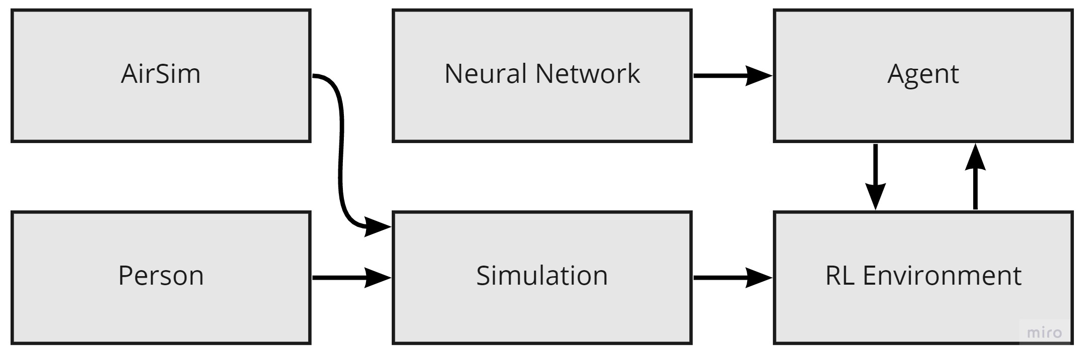
methods
Program architecture

Slide 7
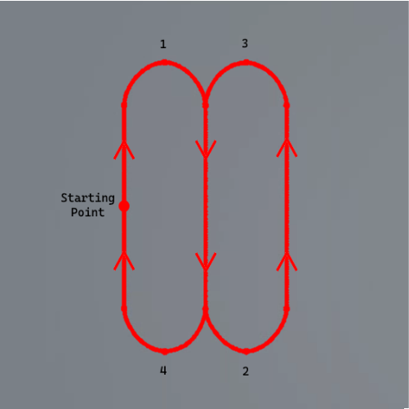
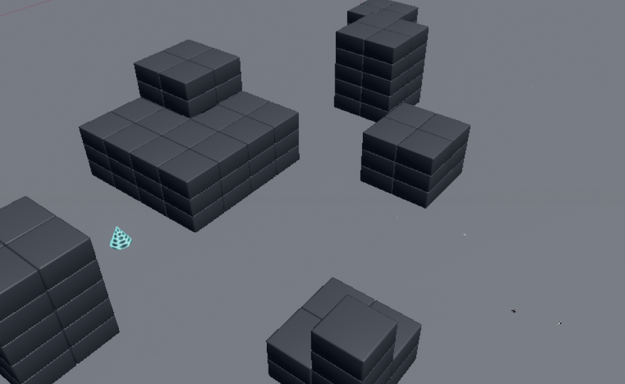
environment
path
Overview

Slide 8
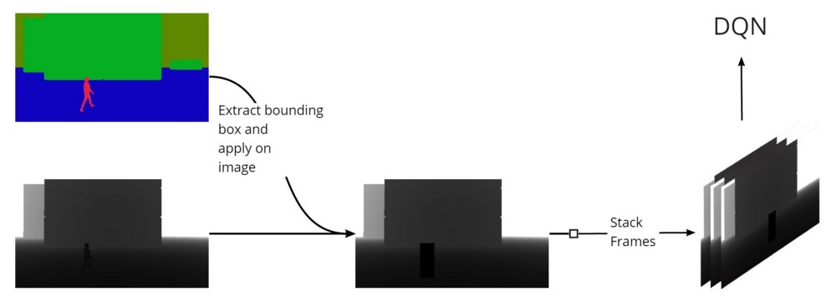
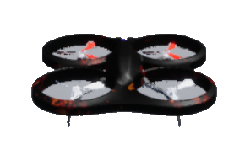
Agents
DQN:
Inputs
Stacked and Depth
Network
Small sized CNN with 2M parameters
Outputs/Actions
5 possible actions
Baseline
Move forward
Move left
Move right
Rotate left
Rotate right

Slide 9
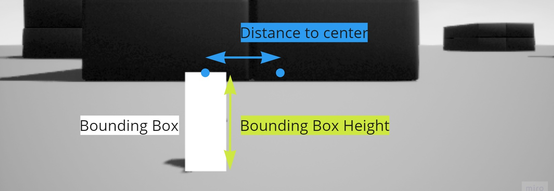
REWARD
Positive reward: +1 | Bounding Box Height = 30% of image height + margin Distance to Center = Center of image width + margin
Negative reward: -1 | Collisions and losing person
Neutral reward: 0 | All other situations

Slide 10
Trained behavior

Slide 11
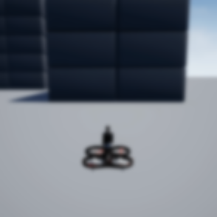
behavior
Baseline
RL agent

Slide 12
behavior
Baseline
RL agent

Slide 13
Physical implementation

Slide 14
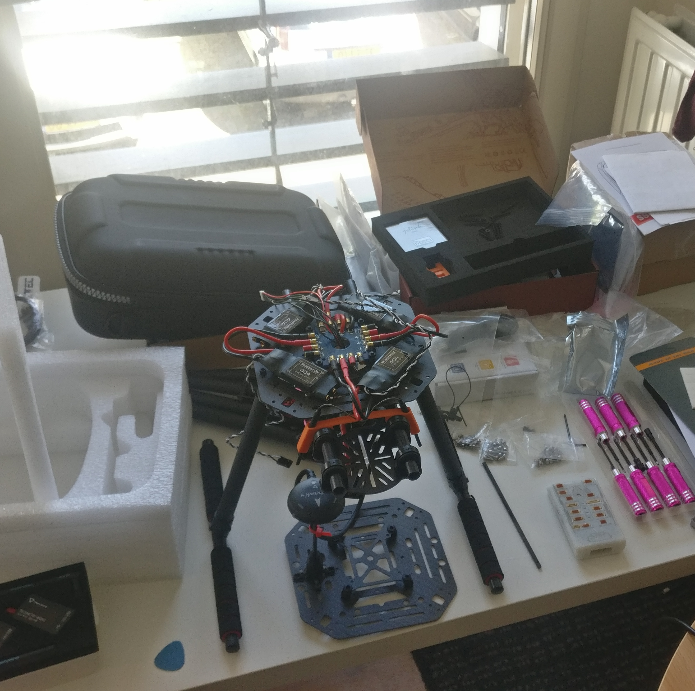
Drone assembly
Easy to follow guide
Set of parts, not a whole
Firmware installation
Calibration
Motors don’t move…

Slide 15
Raspberry pi
Implemented Yolo-Fastest (thank you Jason)
Specifically people detection too!
Adapted the code to suit my needs
Implemented the Baseline Agent

Slide 16
Raspberry pi

Slide 17
Raspberry pi

Slide 18
Questions?

